Slide 1

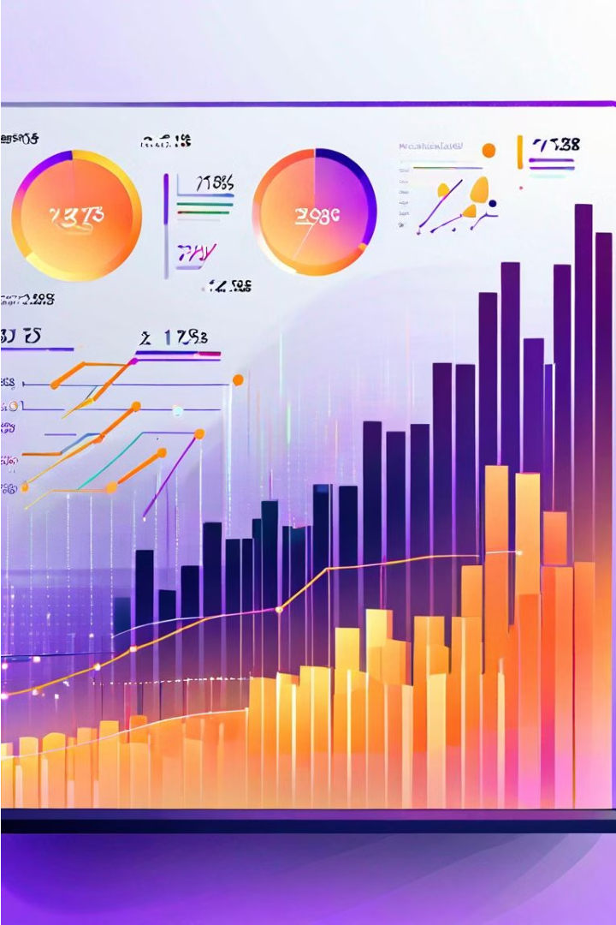

Stock Level Prediction - Data and Strategy
Accurately predicting hourly stock levels is crucial for optimizing procurement and avoiding stockouts or overstocking. This presentation outlines the data sources we'll leverage and the steps involved in building a robust forecasting model.
by srikari malladi

Slide 2

Problem Statement
The goal is to develop a data-driven model that can forecast hourly stock levels for key products. This will enable the business to make proactive, data-informed decisions about procurement, leading to improved inventory management and customer satisfaction.

Slide 3

Data Sources
1
sensor_stock_level
2
sales
Real-time data on current inventory levels from sensors installed in the warehouse.
Historical sales data, including hourly, daily, and weekly transaction volumes.
3
sensor_storage_temperature
Sensor data on the temperature and humidity conditions in the storage facilities.

Slide 4

Modeling Approach
1
Data Preprocessing
Cleansing, transforming, and integrating the data sources into a unified dataset.
2
Feature Engineering
Deriving relevant features from the raw data, such as sales trends, seasonality, and storage conditions.
3
Model Training
Applying machine learning algorithms to train a predictive model on the prepared data.

Slide 5
Model Evaluation
Metrics
Testing
Refinement
Key performance indicators such as mean absolute error, root mean squared error, and R-squared will be used to assess the model's accuracy.
The model will be tested on held-out data to ensure its generalizability and robustness to new, unseen scenarios.
Iterative model tuning and feature engineering will be performed to continually improve the forecasting performance.

Slide 6




Deployment and Monitoring
Deployment
The trained model will be integrated into the company's existing systems, providing real-time stock level forecasts.
Monitoring
The model's performance will be continuously monitored, and feedback loops will be implemented to identify and address any drift or degradation.
Optimization
Ongoing model refinement and updates will ensure the forecasting remains accurate and responsive to changing business conditions.

Slide 7




Business Benefits
Cost Savings
Customer Satisfaction
Operational Efficiency
Business Growth
Improved inventory management reduces the costs associated with overstocking or stockouts.
The insights gained can support strategic decision-making and enable future growth.
Reliable stock level predictions lead to better product availability and happier customers.
Optimized procurement and inventory levels enhance overall business efficiency.

Slide 8
Conclusion
Accurate Stock Level Prediction
Enables proactive procurement and inventory management
Data-Driven Decision Making
Leverages multiple data sources for robust forecasting
Continuous Improvement
Iterative model refinement ensures ongoing performance

